Slide 1
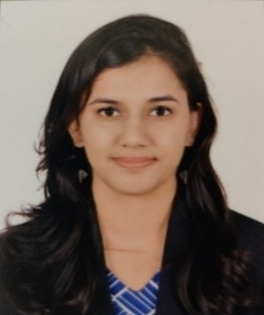
Anusha Kumar: Consultant Analytics & Cognitive
Team Member
Professional Background
Anusha Kumar
Anusha is currently working as a Consultant within the Analytics & Cognitive practise at Deloitte, India. She has 2 years of prior experience working with Deloitte USI as a Business Technology Analyst where she was involved in analysis, design and application development for an Insurance Domain Client.
Anusha is a MSc Business Analytics postgraduate student from University College London, with a background in Engineering, having proven analytical and problem-solving skills. She gained a thorough understanding of numerous data analytics, visualization and machine learning concepts as well as the experience of using the relevant tools and techniques for various academic projects while pursuing masters.
Tools and Technology: Python, R, Azure ML Service, Power BI
MSc, Business Analytics, University College London, London, 2019
BTech, Electronics and Communication, Vellore Institute Of Technology, Vellore, 2016
Relevant Experience
.
Developed a monthly Forecasting model for a Global IT services client to estimate future order booking revenue. Performed data pre-processing and built various predictive models, to estimate revenue for a 3-month forecast horizon, in python and Azure ML Studio, which was deployed through web services and represented on dashboards using Microsoft Power BI.
Performed Text Mining using Azure Machine Learning service on ServiceNow ticket data to understand basic complaints by frequency, flagging tickets on complexity basis median time taken by ticket and identify tickets that can be automated to provide resolution.
Worked with business stakeholders of a PSU banking client to understand their data requirements to deliver a data strategy and migration roadmap for amalgamation. This involved identifying their business capabilities and pain points to develop a solution design and implementation roadmap.
Performed a POC for an Automobile Industry client to identify customers in the existing base having high propensity to re-purchase in the next cycle. Analyzed the historical purchase data and utilization of vehicle service data to perform customer segmentation.
Worked with a UK based IT and services company to build a client targeting dashboard. Performed business and requirement analysis to create an Interactive Management Dashboard to help communicate the value and potential insights derived from the application of Data Science techniques to the leadership.
Been a part of a US based Insurance client project in implementing a full suite to improve their policy and claims system. This involved understanding the existing end to end development of different products, gathering relevant data and software requirements and implementing the proposed solution in production. Led daily stand-up meetings with on-site team providing them with a status of the work done.

Slide 2
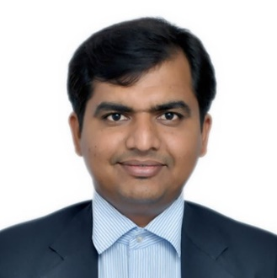
Ankitkumar Velani: Consultant Analytics & Cognitive
Team Member
Professional Background
Ankitkumar Velani
Ankit is currently working as Consultant within Analytics and Cognitive vertical at Deloitte, Bengaluru, India. He has 6+ years of work experience in advance analytics and software development. He is well equipped with business intelligence tools and can leverage them to build tailored advance analytics and visualization solutions for CPG, Retail, Online Learning and IT domain.
Tools & Technology:
Business Analytics, Predictive Modeling, Airflow, AWS and GCP Cloud Services, Chatbot Development, Advance NLP & Text Mining, Tableau, R, Python, REST API, Micro Services, Flask-Web Apps.
Masters of Computer Application – Siddaganga Institute of Technology , Tumkuru
O-Level , NIELIT, India
Relevant Experience
.
Trade Promotion Optimization: Developed end-to-end automation pipeline framework to process and prepare larger chunk of data using Google Airflow and BigQuery environments. This pipeline helped to map various spends and promotions data at transactions level and to get deep drive on sales at different granular level like Customers , Distributors, Sales Channel, Chain.
Advance Chatbot: Developed end-to-end Chatbot framework to deliver quick responsive system for CPG domain. Chatbot can process the user inputs in free text / voice input and provide solutions with interactive visualization and insights. Enabled REST API to integrate Chatbot framework with Web App and Mobile Handed devices.
Tone Analyzer: A solutions framework to deliver insights on contact Centre conversation for a large MNC Banking. The project had automatic quality monitoring using advance analytics, Analyzed Speech & Text to delivered Call Quality index and recommended the best article to the conversation.
Customer Analytics: Developed a Social Media processing framework for CPG products to identify and extract the reason behind the sentiment. It helped to improve the product quality and market engagements.
Customer Overdue Analysis: Developed a Payment Overdue & Provision solutions framework using Tableau to analyze the various insight by Geography level, Distribution Channel & Customers.
Subscription Analysis: Developed a Subscription solutions framework using Tableau to analyze the various insight by Geography Level, Category and Courses. Enabled REST API over the cloud to transfer data system to system for LMS(Learning Management System).

Slide 3
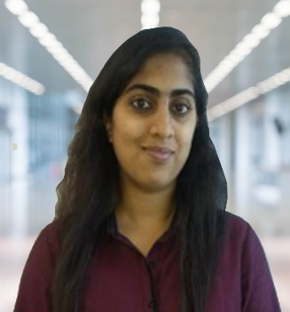
Sudeshna Dutta: Consultant Analytics & Cognitive
Team Member
Professional Background
Sudeshna Dutta
Sudeshna has ~3 years of experience in Data analysis and currently working as Consultant within Analytics and Cognitive practice at Deloitte India. She has experience in Data Handling and Analysis for a retail clients. She has undergone classroom training in Data Science using R during her first job at Infosys and has certification in Data Science and Machine Learning course using Python at INSAID (International School of Artificial Intelligence and Data Science).
She has keen interest to work on data analytics, data visualisation, Machine learning algorithms and learn more about these at a good pace, in real time environment scenarios. She is currently working for a fuel retail client leveraging data science knowledge and using python and aws sagemaker to deliver insights. She has also worked on 4 data science projects using Python as part of the certification and published 3 articles on Medium Digest.
Tools & Technology: Python, R, Social media analytical tools, Excel, Tableau
Masters in Economics – Madras School of Economics
Certification in Data Science from INSAID
Relevant Experience
.
Performed customer analytics for a Canadian fuel retailer using various segmentation techniques like K-means, RFM, Dynamic Time Warping and identified different trends and patterns in segments for business to take action.
Worked on data processing to understand transaction x demographics data for Canadian gas stations and did extensive exploratory analysis on given hypothesis. Use Tableau to communicate results to business
Performed text mining, sentiment analysis for leading sportswear manufacturer to optimise brand value and conversion rates, using 3-fold analysis for every product campaign on social media – Pre-campaign Analysis, Ongoing Analysis and Post-campaign Analysis where the product was compared against previous campaigns and also competitor products to understand the overall product performance and consumer perception about the product.
Published 3 articles on Data Science using medium digest’s platform:
Article 1 , Article 2 , Article 3

Slide 4
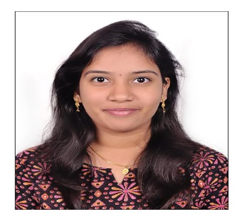
Mounika Katakam : Consultant Analytics and Cognitive
Team Member
Professional Background
Mounika Katakam
B.E(Electronics&
Communications
Engineering),
SRKR College, Affiliated
to Andhra University,
Bhimavaram.
Mounika is currently working as a Consultant within Analytics and Cognitive vertical at Deloitte, Bengaluru, India. Mounika has extensive background in Implementing Analytics solutions that provide strategic recommendations to solve business problems.
She has 5 years of experience in Machine Learning, Predictive Analytics, Model Building, Validation & Data Visualization. Worked on Supervised learning algorithms like Linear Regression, Logistic Regression, Decision Tree, Random Forest, KNN ,SVM, XGBoost and Unsupervised learning algorithms like K-Means, also performed NLP and Fraud Detection techniques.
Tools & Technology: Basic familiarity with C3.ai(Beginner), Python, R and SQL
Relevant Experience
.
Worked on demand forecast model to predict the demand of the spare parts for an automobile industry at retailer and distributor level. Implemented Croston-SBA method to predict the intermittent demand forecasting.
Performed Attrition Analytics on Employee data of Deloitte India to find the Attrition scores for practitioners along with the top risk drivers for active employees using LIME. We have developed this algorithm to predict the employees who will be leaving the company in future.
Worked on Multi-variate time series model to forecast Revenue and to provide self-service automated tool by integrating Power BI with R.
Built regression model to calculate the optimum interest rate for the customers of one of the leading banks. By using our solution, the time spent by bank employees on calculating the interest rate was reduced drastically.
Designed regression model to suggest the amount of loan to be given to the customers based on their previous behavior. When a person apply for loan, previously the amount of loan was decided manually. Developed an algorithm to suggest the maximum amount of loan to be given to the customers.
Performed NLP on the credit card reviews data to find out whether the reviews given by the customers are positive or not.
Worked on clustering of customers who has similar behavior for insurance company. Suggested plans for the new customers based on the clusters formed.
Performed classification of customers who should be targeted for the insurance plan. This has helped the company to only target specific set of people instead of everyone and reduce time and resources.

Slide 5
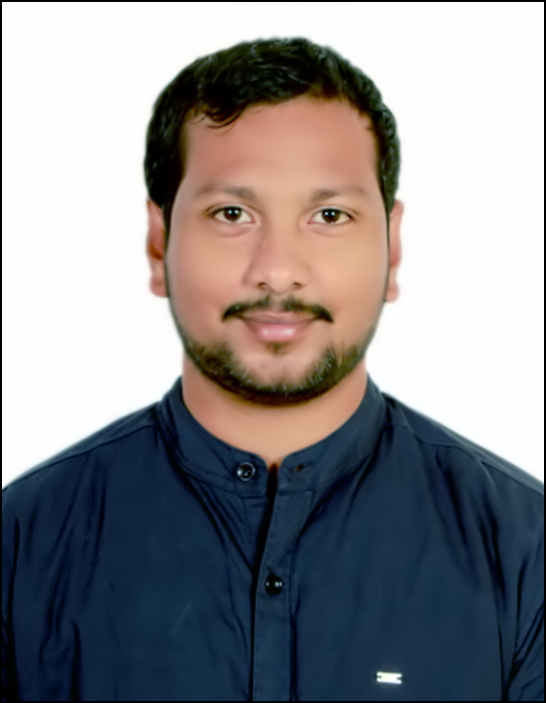
Hemanth Karuturi: Consultant Analytics and Cognitive
Team Member
Professional Background
Hemanth Karuturi
Hemanth is currently working as a Consultant within Analytics and Cognitive vertical at Deloitte, India. Hemanth has extensive background in Implementing Analytics solutions and leading high performing analytic teams that provide strategic recommendations to solve business problems.
Expertise in the application of R and Python with nurtured in intelligent implementation of various statistical and predictive modelling techniques in the field of Banking and Digital Marketing analytics. In addition to strong technical skills, attained a very good management experience in strategic planning, client handling, project execution and delivery.
Tools & Technology: R, Python, SAP Analytics Cloud, SAP Analytics Application designer, SAP Data Intelligence and SQL
B.Sc (Maths, Physics, Computer Science)
Adhikavi Nannaya University
Relevant Experience
.
By extracting reviews and comments from different social media platforms, implemented a solution to find the customer satisfaction levels on the services provided by US Bank.
Built a Customer Segmentation model for US Bank using cluster analysis based on customer behaviour for classifying the customers to provide the target advertisement.
Implemented a Sentiment Analysis dashboard to understand the effectiveness of the campaigns conducted by a political party in AP.
Built a Lead Generation Chatbot using Google Dialogeflow to replace the existing customer chat by drastically reducing the operation costs for the Lead Generation.
Implemented a python application that can extract data from Quick View files provided by GFK (Growth From Knowledge), by eliminating third party data source provider.
Implemented Recommendation Engine to increase the sales by 2x for a product based company.
Running and implementing different dashboards in Digital Marketing Analytics.
Implemented SAP Analytics Applications for Financial Planning and Forecasting, and Transfer Pricing to enable users for making data driven decisions by doing simulated forecasts, dynamic chartings and providing AI features with simple user interface.
Setting up python/R pipelines in SAP Datahub/Data Intelligence platform for automating the data processing and analytics tasks.
Assisting and Implementing the SAC Storyboard for the stakeholders on Ad-hoc basis.

Slide 6
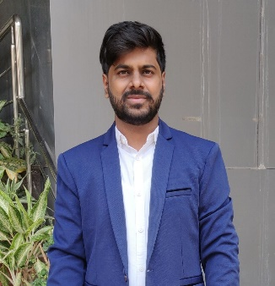
Shivappa Gundlur : Consultant Analytics and Cognitive
Team Member
Professional Background
Shivappa Gundlur
Shivappa is currently working as Consultant within Analytics & Cognitive department at Deloitte Touche Tohmatsu India LLP. Shivappa has extensive experience in the Telecommunications, Market Research, E-commerce, Sales & Marketing.
Shivappa has acted in the capacity of a statistical consultant on various projects and gainfully contributed in Predictive modelling, Advanced analytics, Machine learning, Text mining, Sentiment analysis, NLP and Time series analysis.
Tools & Technology: R, Python, NLP, Machine learning, Tableau
Masters in Statistics – University of Mysore, Mysore
BSc in Statistics – Karnataka University, Dharwad
Relevant Experience
.
Shivappa has worked for around 5+ years in this field of predictive analytics comprising of Risk analytics , Survival Analytics, Marketing analytics , Unsupervised clustering ,Supervised learning, Unsupervised learning, pricing analytics and data visualization . He has knowledge about Regression Models , Decision trees , Random Forest , Naive Bayes , Market Basket Analysis , Chatbot Development, NLP etc.
Built the model to find out propensity of each sales pipeline in the organization using classification techniques and prepared tableau dashboard to monitor the sales pipeline prediction.
Used sentiment analysis to get customer sentiment in the feedback data. Found the topic of discussion in different verbatim in the data containing customer feedback or comments. For topic modelling, Latent Dirichlet Allocation (LDA) and supervised machine learning algorithms like Support Vector Machine (SVM) and Random Forest models were used, after data was cleaned and prepared. Finally used Tableau to display results.
Built an automated and self-learned Text Mining platform which will work with any text data to categorize these texts into multiple classes (known or unknown), irrespective of domain or industry and then predict faults. Classified text columns were trained to use Latent Dirchilet Allocation and name the topics accordingly. We used time series pattern recognition to find out Patterns in LDA output over the time and then clustered them into similar groups. Then we trained attribution model by taking actual fault as target variable. The result had intelligent identification of most coherent topic which predicted faults for next day by seeing 5 previous days’ lag classes. Dashboard was developed to identifying irregular behavior of the topic.
Implemented a holistic program to monitor, measure and proactively manage the churn of broadband customers. Supervised learning algorithm such as Logistic Regression, Support Vector Machines and Random Forest were deployed to allocate risk or propensity scores for each customer with information such as customer demographic information, customer complaint data, billing data, usage information etc.
Worked on demand forecasting to help demand planners to plan sales accordingly by each month to increase their sales. Statistical forecasting models were used to forecast demand for each product in an organization. Used R tool to the analysis and reported
Worked on market mix modelling to derive important marketing drivers to improve the revenue. Built the marketing spend optimizer tool to allocate marketing spend across all the channel so that business will reach maximum revenue.
Used statespace models in R to build the MMM model and created excel based optimizer tool with business constraints

Slide 7
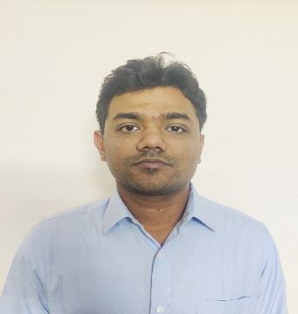
Akshay Dighe: Consultant Analytics and Cognitive
Team Member
Professional Background
Akshay Dighe
Akshay is currently working as an Consultant within Analytics and Cognitive vertical at Deloitte, India. Akshay has extensive background in Implementing Analytics solutions using Python, AWS, Machine Learning, Deep Learning and Natural Language Processing.
He has led engagements within India demonstrating expertise in building and deploying analytical models. He has worked on engagements in text analytics, chatbot development, anomaly detection, face recognition.
Tools & Technology: R, Python, AWS, Flask, NLP, Machine Learning, Deep Learning
BE (Computer Engineering): G.V.Acharya Institute of Engineering and Technology, Mumbai
PGP in Big Data and Data Science: Aegis School of Business, Mumbai
Relevant Experience
.
Sentiment Classification: Build and deployed sentiment classification model using deep learning which was integrated into social media analytics and customer engagement platform to generate social media insights about the customers such as the online buzz created by the brand and how effective are the marketing campaigns. This insights helped in reducing negative chatter related to the customer, identify important conversations and control negativity about the customer brand
Anomaly detection: Build and deployed anomaly detection system for an social media analytics platform which was used to identify if there is sudden rise in engagements for a brand over social media. This helped to identify key topics and trends related to the customers
Face recognition: A Professional business services enterprise wanted to create an attendance system for their on-field employees. Build and deployed face recognition system which was used in attendance system application in Android and IOS
Resume Parsing and Resume Ranking: A Leading HR Outsourcing company and a recruitment agency wanted an application wherein the process of shortlisting candidates for a specific job description would be optimized. Built an application which helped in extracting the candidate details from the resumes of different file formats and Ranked the resumes according to the similarity with the job description
Chatbot: A Leading HR Outsourcing company wanted to build an chatbot which helped in answering queries related to the Onboarding, Payroll, HR and compliance. Build an chatbot using RASA NLU, Python and Flask which helped in reducing and freeing up staff
Customer Segmentation: A Leading Commercial Vehicle Manufacturer wanted to find out customers who have higher probability of repurchasing a vehicle. Build a Clustering model based on RFM using customer purchase data. The Clustering results were combined with vehicle utilization analysis for each customer to get customer priority as High, Medium and Low
Data modernization using AWS Services: For an US pharmaceutical Client, Worked on Data ingestion pipeline and ETL transformation of Data using AWS Services such as Lambda, Glue, CloudFormation, CodePipeLine and Athena.

Slide 8
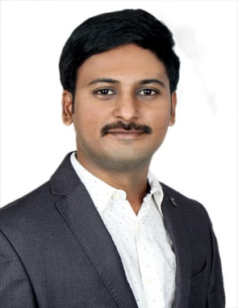
Lohith Pyda: Consultant Analytics & Cognitive
Team Member
Professional Background
Lohith Pyda
Lohith is currently working as a Consultant within Analytics and Cognitive vertical at Deloitte, India. Lohith has extensive background in implementing Analytical solutions and worked with various clients from different geographies to solve business problem for Telecom, Airlines and Insurance industry.
He has led engagements with various clients in building and deploying predictive analytical models and deep learning based solutions. He has worked on engagements in Deep Learning, predictive analytics and NLP.
Tools & Technology: Deep Learning, Machine Learning, NLP, Python
Graduate – Gitam University
Deep Learning specialization (coursera)
Relevant Experience
.
Worked on claim adjudication for medical insurance client in reducing the cost of manual intervention of pended claims by using ML techniques to predict payment/denial of medical claims.
Performed sentiment analysis on rubber and steel news articles for the leading Indian industrial and services group, which helped the customer to keep a track of market trends and provide a comprehensive view point with easy and user-friendly interfaces.
Performed fraud analytics on order data of the leading telecommunication client using various classification models, which helped the customer by identifying the orders that are likely to be fraudulent, and in turn helped to minimize losses.
Implemented email classification model for largest private bank in South America region, which helped the customer in addressing users with correct response using neural network.
Built the lounge occupancy model to predict the likely visit of customer to the lounge and lounge occupancy count at a given date and time for major airlines of the united stated.
Performed Automatic tagging of clothes for E-commerce company. Classified images of apparels like shirt, T-shirt, Trousers etc. which creates annual value from AI techniques.
Developed a prototype for face detection and face recognition in both image and video using deep learning techniques to the leading insurance company in the world.
Performed regression analysis on order journey from order placement to device activation, predicted the date in which the order would be confirmed, shipped, delivered and activated for the leading telecommunication client.

Slide 9
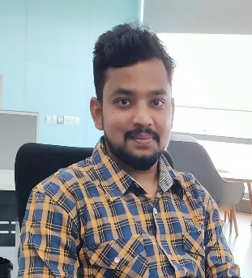
Sridhar Kulkarni : Consultant Analytics & Cognitive
Team Member
Professional Background
Sridhar Kulkarni
Sridhar is currently working as a Consultant within Analytics and Cognitive vertical at Deloitte, India. He has about 4 years of experience into the field of Data Science & Analytics with hands-on experience in Predictive modelling, customer value management, Time Series Forecasting, Whitespace analysis.
He has worked with stakeholders across geographies and his major role is to interact with the stakeholders to understand the scope of business problem, provide insights / recommendations by performing descriptive and predictive analytics.
Tools & Technology - R, Python, SQL, Microsoft AzureML, Machine Learning, Data Science.
B.E (CSE) – KLE Institute of Technology, VTU
Azure Cloud Data Science Certification from Microsoft
Relevant Experience
.
Sridhar has analyzed and Forecasted Oil Consumption in across multiple region and on Weekly and Monthly basis using various Time series and Regression models which has helped the sales team in building their strategies to manage the production and sales activities
Implemented a Predictive Analytics Model for an Internal Product to perform Whitespace generation which helps in finding out the potential Upsell and Cross-Sell opportunities for the customer using Customer Profiling techniques
Worked on the Predictive Maintenance for a leading wind power company for an AI driven maintenance of the turbines based upon the values generated by the sensors, this helped client in reducing downtimes and thus increased profitability by 10-15%
Attrition Analytics: Created employee segments for leading IT products company using logistic regression and K-Means clustering, and prepared personas to identify employee at risk of attrition to mitigate risk and take corrective actions
Worked for a leading retail giant to build a predictive model to predict the sales of each product at particular stores. The model was used to understand the attributes of products and stores which play a key role in increasing sales.
Sridhar has experience in Azure ML platforms and he is a Azure Cloud Data Science Certified Professional. He has experience working on Azure ML Studio and Azure Machine Learning Services.

Slide 10
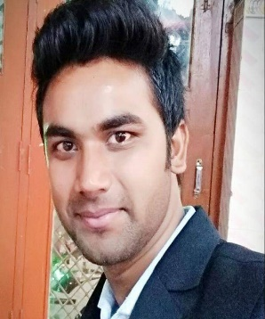
Alok Kumar : Consultant Analytics & Cognitive
Team Member
Professional Background
Alok Kumar
Alok is currently working as Consultant within Analytics & Cognitive department at Deloitte Touche Tohmatsu India LLP. Alok has extensive experience in the Banking and Finance, Travel, Market Research.
Alok has worked for around 5 years in advanced analytics consulting, generating business value for clients through data-driven solutions. Worked for several large clients across Banking, ERP, Marketing, Travel sectors. He has knowledge about predictive modelling, Regression Models , Decision trees, Time series analysis , Random Forest , Naïve Bayes, Computer Vision, NLP etc.
Alok has worked on various projects and gainfully contributed in Predictive modelling, Advanced analytics, Machine learning, Text mining, Convolution neural networks (CNN).
Tools & Technology: R, Python, SQL, Git
B.Tech in computer Science & Engg ,Asansol Engineering College
Relevant Experience
.
Building Automated Commodity Price Forecasting tool in python, deployed on cloud. This tool is capable of doing feature engineering, feature selection, model building and generating result(includes inventory related analysis) that published on hosted dashboard.
Developed omni channel(voice, chat) contact centre on cloud to handle appointment service for the users of client’s products.
Built and deployed Rubber stock price prediction model on cloud, which includes technical analysis and modelling on different Rubber variants using time series analysis and deep learning (Long short-term memory)
Built predictive model to predict Airline arrival/departure delay . Modelled airline, air traffic and weather data to predict arrival/departure delay using Machine learning and Statistical modelling.
Automated safety monitoring system, Developed model and deployed to serve as rest API, which monitors safety violation like workers not wearing safety kit, or entering to danger zone, using computer vision , convolutional neural network.
Modelled customers and Asset inflow on Media spend to explain the impact of individual marketing channel on business outcome using machine learning and Bayesian inferences.
Developed employee management system which led the identification of best fit employees for project requirements at scale. Steered the usage of mathematical model to score each employee against projects then used optimization to recommend employees for projects.

Slide 11
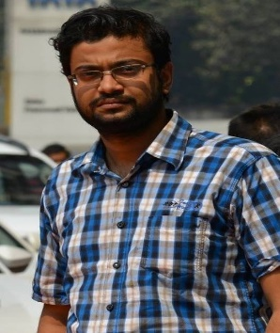
Hindol Ganguly: Consultant Analytics & Cognitive
Team Member
Professional Background
Hindol Ganguly
Hindol is an M.Sc in Statistics & having statistical modeling experience of nearly 4 years.
He has expertise in Data Science, Machine Learning, Predictive Models and other analytical algorithms. Hindol has worked in Operational risk management, Retail, Customer analytics & supply chain domains
Tools & Technology: R, R-Shiny, Python, Pyspark, SAC-Datahub
Masters in Statistics – Kalyani university
Relevant Experience
.
Key contributor of the solution framework for a leading Lighting manufacturer, by predicting the sales of new innovative products, before it’s actual launch. The solution is helping business to take optimized decisions in terms of launch time, campaigns, & to target market and customer sectors
Built interactive dynamic dashboards capable of displaying KPIs & performing statistical calculations, for one of the largest Pharmaceutical companies in the globe
Contributor as an Analyst to Operational risk management for a leading Aviation industry by helping them to mitigate the loss due to overbooking of cargo goods, using through well structured machine learning approaches. It supported the business to track, understand the patterns of different customer behaviours and the factors mostly responsible to cause over/under booking
Provided solution for a leading telecom industry by predicting the probability of downfall of their service towers for a particular problematic zone business was concerned with. The approaches involved NLP to understand the generated system logs, followed by survival analysis & association rule mining. The solution helped the business to take optimized decision hence reducing the operational cost & manpower
Provided product & customer specific analysis for a leading Retail manufacturer to better predict the demand while identifying the important customers at the same time
Built predictive models to identify potential fraud or loan defaulters as a tool-based solution for banks
Part of stress testing team for a leading bank in Middle East, which outlined the VAR (Variance autoregressive models) methodology to predict the PPNR (Pre-provision net revenue) of the portfolio
Provided solution for a leading Media, by analysing the text data from their respective twitter handle for a particular time frame, to understand the most trending topics, debates & discussions
Built binary/multiclass classification models for a leading travel company, to predict potential customers to be notified regarding some special campaigns/offers

Slide 12
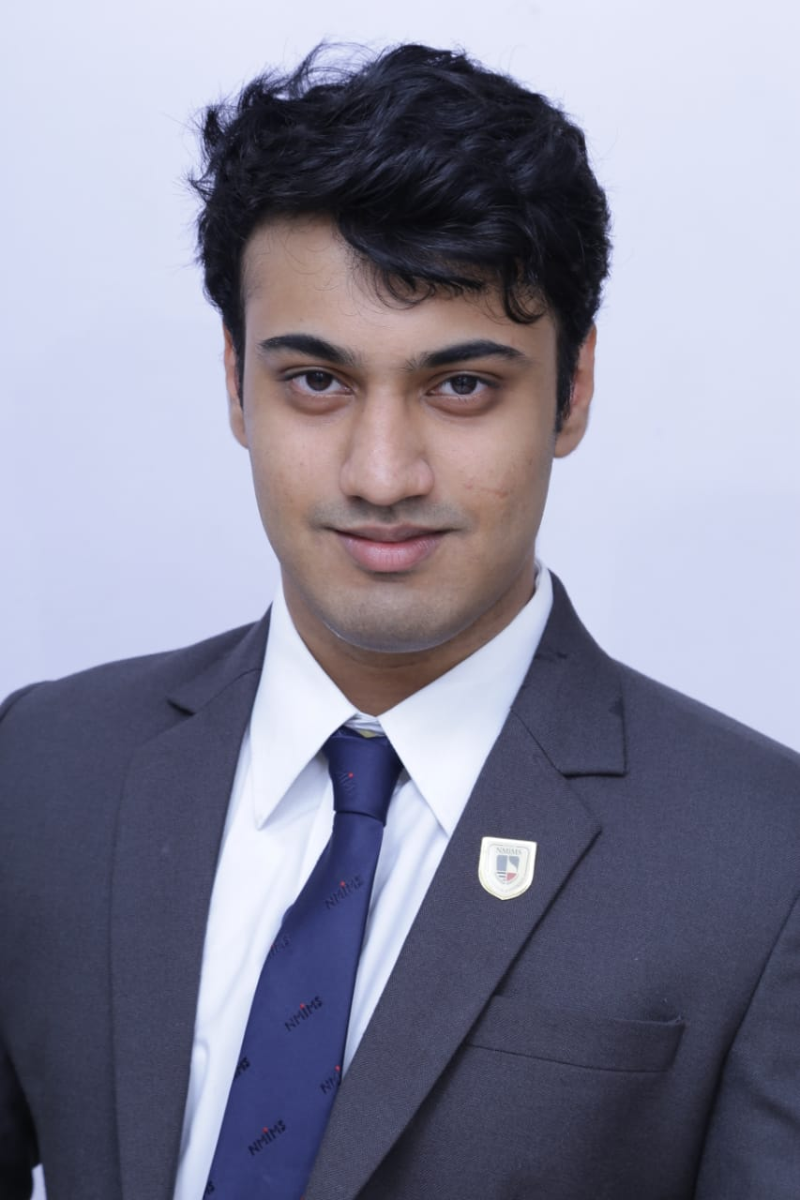
Roshan Raghuram: Consultant Analytics & Cognitive
Team Member
Professional Background
Roshan Raghuram
Roshan is currently working as a Consultant within Analytics and Cognitive vertical at Deloitte, India. Roshan has graduated from NMIMS with a dual degree having MBA in Business Analytics and B-Tech in Information technology
He has interned at multiple places such as Deloitte DTTL, IIT Bombay and SimSol Ltd. Etc in the areas of Data Analytics and Data Management.
Tools & Technology: Machine Learning, Python, R.
MBA – Tech
MBA – Business Analytics
B-Tech - IT
(Dual Degree)
NMIMS University
Relevant Experience
.
Helped build Regression and Tree Model to identify most significant factors impacting sales for a leading tire manufacturer at Deloitte DTTL during Internship.
Part of project at IIT Bombay to build Chat-Bot using NLP and Deep Learning during internship. Created model using LSTM - RNN.
Performed Operation Analytics to identify warehouse requirements using Time Series modelling at Bangera Seaworld Ltd. Helped company reduce cost of storing raw materials.
Responsible for creating database schema and data management at Simsol Technology and Services Ltd.
Worked on multiple projects at college as part of course curriculum on different problems like Market Basket Analysis, Price Sensitivity and demand forecasting using different ML algorithms.

Slide 13
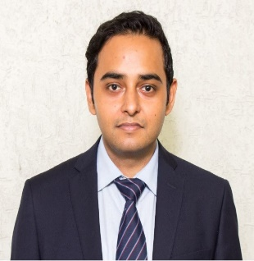
Ankur Aman : Consultant Analytics & Cognitive
Team Member
Professional Background
Ankur Aman
Ankur is currently working as a Consultant within Information, Management and Analytics Solutions at Deloitte, India. Ankur has a prior experience of working in different domains like semi-conductor, automobile and Oil & gas as a lead engineer. As a lead he was responsible for developing concept designs, simulations and quality checks. He was also involved with interfacing design tools with SAP PLM.
Tools & Technology: Python, SPSS, Minitab and Power BI
Post Graduate Program in Management (Operations and Analytics) – Management Development Institute
Relevant Experience
.
Developed a monthly Forecasting model for one of the biggest IT services client to estimate future order booking revenue. Performed data pre-processing and built various predictive models, to estimate revenue for a 3-month forecast horizon, in python and Azure ML Studio which was deployed through web services and represented on dashboards using Microsoft Power BI. The model developed was also scheduled to run monthly on Azure DevOps.
Performed Text Mining using Azure Machine Learning service on incident data to understand basic complaints by frequency, flagging tickets on complexity basis median time taken by ticket and identify tickets that can be automated to provide resolution.
Worked extensively on a project related to Natural Language Processing to build a model with 88% accuracy for Sentiment Analysis. The project was also selected in Top – 5 out of 174 entries in Business Standard Best B-School Project Awards.
Worked on an academic project for Gauging Service Quality of a Government Hospital in India by using SERVQUAL model to identify gaps, measure quality and purpose solutions to improve response time.
Did Exploratory Data Analysis and Strategic Planning on a live project on Silk Industry to identify the pain points for the weavers and purpose solutions. Insights gathered during the project enabled the weavers to increase their income by 22%.
Performed project on Analysis of the Factors Affecting Prices of Real Estates in academics. Carried out multivariate statistical regression analysis to study the factors influencing real estate prices. Performed EDA, heteroskedasticity test and checked for multicollinearity and omitted variable bias.
Did a project on prediction of sales price of house using Regression Techniques in academics. Created Correlation matrix, performed EDA, Feature engineering and Multicollinearity checks. Applied two regression models namely Ridge regression and Lasso Regression.

Slide 14
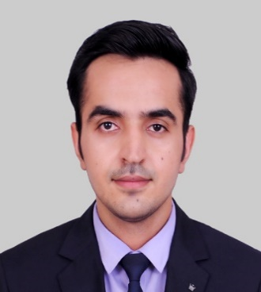
Ashish Dhuwan: Consultant Analytics & Cognitive
Team Member
Professional Background
Ashish Dhuwan
Ashish is a consultant with the Strategy, Analytics & Cognitive service line. He has over 3 years of valuable experience in the Business analysis and data application strategies. He has analyzed business requirements and developed data based solutions across different verticals providing him the techno-functional expertise.
He is an MBA majoring in strategy & analytics from VGSoM, IIT Kharagpur. He has expertise as a business analyst in understanding and interpreting datasets across business verticals while working with consumer, automotive and financial companies. He has experience in the project management, data analysis, functional validation, Microsoft PowerApps & business intelligence with tools like PowerBI, R.
Key Competencies: Business Analysis, IT Strategy & Roadmap, Data Analytics & Reporting, Requirement Gathering & GAP Analysis, Business Intelligence, Agile Project & Delivery management, Stakeholder Management.
Tools and skills: Agile Development, Jira, MS Azure, AWS, MS PowerApps, Power BI, AWS Quicksight, R
MBA in Strategy & Analytics
(VGSoM, IIT Kharagpur)
B.Tech., Computer Science Engineering,
GGSIPU, Delhi
Relevant Experience
.
As a business analyst, Delivered multi-technology program including building customer data lake supporting business needs and technology roadmap, enabling client to address customer specific requirements with accuracy leading to greater operational accuracy and growth.
Designed and developed MS PowerApps & Power Automate solutions for a leading UK based automotive client for supply chain operation including the stakeholder and vendor management. Also, assisted with document control and data security-based requirement fulfillment for client functional team.
Collaborated with different team members to design, develop and demo the analytics use case dashboards for the customer value management solution for telecom industry.
Gathered and translated technical & functional requirements into the detailed development plan for release schedules of the business application. Scope included building and managing the roadmap, customer interactions and driving the engagements with different product owners.
As a business analyst, conceptualized and completed the GAP analysis for a PowerApps solution of procurement operations workflow for a pharmaceutical client
Understood and developed the client’s functional and technical requirements to build the consolidated financial planning solution for different business units.
As a functional consultant, responsible for managing the functional validation, building of test and use cases, integration testing of the financial budgeting and planning solution of a UK based Insurance client.
As a business analyst, Designed the PowerBI insight reports wireframes for business strategic initiatives of supply chain functions as per the gathered requirement.
Analyzed business requirements and developed a Proof of concept(PoC) of Global business services control tower analytics capabilities for different functional levels through PowerBI dashboards and Azure SQL database.
Designed a framework of process transformation for the Regional Delivery Center teams for the delivery of Cloud Managed Services.
Designed and delivered technical solution features using agile methodology for the event management platform of the Cvent - Global leader in MICE industry.

Slide 15
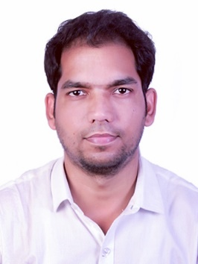
Satishkumar Pandey : Consultant Analytics and Cognitive
Team Member
Professional Background
Satishkumar Pandey
Satish is currently working as a Consultant within Analytics & Cognitive Solutions at Deloitte, India and has 5+ years of experience. Satish extensively worked on development and validation suite of ML and advanced analytics models.
He has Principal responsibilities include working with structured and unstructured datasets and handling diverse Data Science Projects across wide spread domains and multiple technological frameworks.
Tools & Technology- Python, R, SAS, Altrex, Airflow, GCP
Masters in Statistics – Mumbai University
Artificial intelligence & Robotics Process Automation- Anexas Europe
Relevant Experience
.
Working with Colgate-Palmolive on Gross-to-net optimization for consumer and customer. The objective to identify the opportunity to improve Gross-to-net spends efficiency and efficacy in driving revenue growth in line with the advanced analytics. We are using Airflow, Jupiter notebook , Big-Query & G-suite for analysis.
Developed a forecasting model for CEAT to estimates the future demand for motorcycle tires .The objective to predict the monthly demand for motorcycle tires for distributors. Deployed XGB based model to predict the monthly demand.
Developed a forecasting model to provide the Vehicle replacement strategy for Northern Gas Networks(UK), operating 500+ vehicles in the field. The objective was to identify the right time to replace the vehicle to reduce the maintenance cost. Deployed ARIMA based model for different segments of vehicles to predictive maintenance cost with depreciation rate to find the optimum time for vehicle replacement.
Developed and validated a full suite of credit risk models to source multiple financial products. The scope of the model to identify good customers based on banking, demographics and bureau information. Multiple advanced analytical models were built for different products and deployed on the server for leading NBFC.
Worked on customer behavior scorecard to improve the collection strategy and identify the customer at risk to default. The objective was to identified the priority customer to focus to reduce the default rate. Deployed an ML-based model to segment the customer based on the priority of risk band for leading NBFC.
Worked on the Pre-delinquency Management model to identify customers having a high probability of defaulter and improve recovery for 0 bucket customers. Deployed an advanced analytics Model get improved the flow rate form 36% to 18% including pre-delinquency, Bucket X. Based on the scorecards, multiple collection strategies were developed to improve the collection process.

